Slide 2
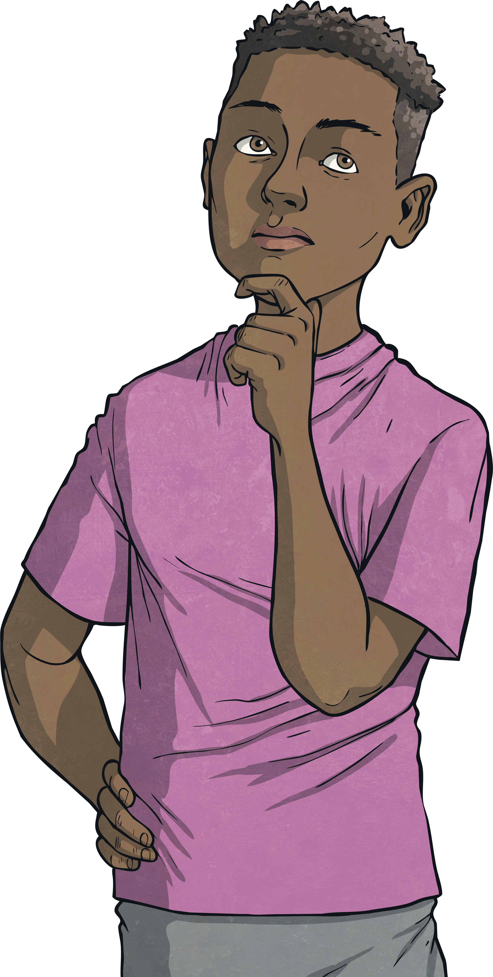
7²
9²
11²
6²
What is a Square Number?
2²
4²
A square number is the product you get when a number is multiplied by itself.

Slide 3
7²
9²
11²
6²
For Example…
2²
4²
2 x 2 = 4
4 is a square number because it is the product of 2 multiplied by 2

Slide 4
7²
9²
11²
6²
5 x 5 = 25
2²
4²
Can you explain why 25 is a square number?
25 is a square number because it is the product of 5 multiplied by 5.

Slide 5
7²
9²
11²
6²
12 x 12 = 144
2²
4²
Can you explain why 144 is a square number?
144 is a square number because it is the product of 12 multiplied by 12.

Slide 6
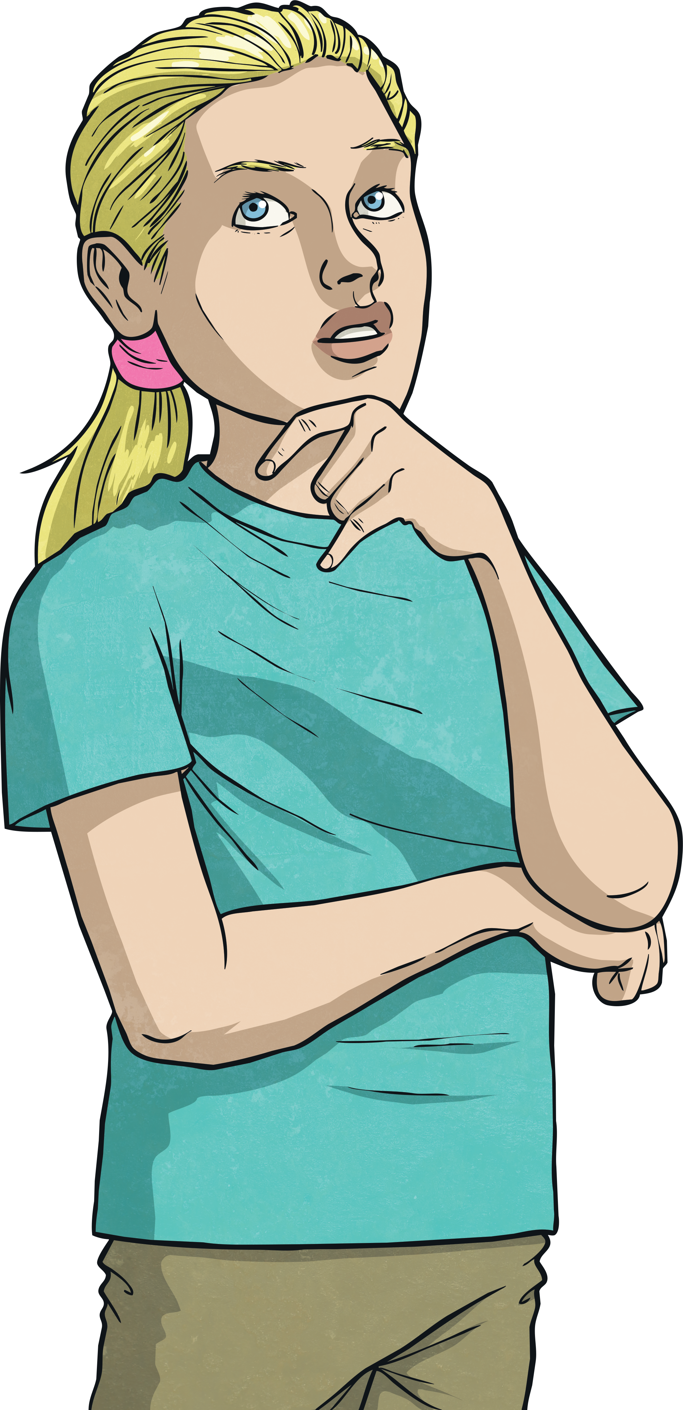
7²
9²
11²
6²
Where do square numbers get their name?
2²
4²
Square numbers get their name from the square shape they can make.
This square shows
2 x 2 = 4

Slide 7
7²
9²
11²
6²
Let’s look at more square numbers!
2²
4²
This shows 1 x 1 = 1

Slide 8
7²
9²
11²
6²
2²
4²
This shows 3 x 3 = 9

Slide 9
7²
9²
11²
6²
2²
4²
This shows 4 x 4 = 16

Slide 10
7²
9²
11²
6²
Can you work out what square number is illustrated here?
2²
4²
This shows x = .
This shows 7 x 7= 49

Slide 11
7²
9²
11²
6²
Can you work out what square number is illustrated here?
2²
4²
This shows 6 x 6 = 36.
This shows x = .

Slide 12
7²
9²
11²
6²
6 x 6 = 36
2²
4²
We can also write this as 6² = 36

Slide 13
7²
9²
11²
6²
2²
4²
If 6 x 6 = 36 we can say that the square root of 36 is 6.
This is how we write it, √36 = 6

Slide 14
7²
9²
11²
6²
2²
4²
4 x 4 = 16
or
4² = 16

Slide 15
7²
9²
11²
6²
What is the square root of 16?
2²
4²
4² = 16, therefore √16 = 4

Slide 16
7²
9²
11²
6²
2²
4²
3 x 3 = 9
or
3² = 9

Slide 17
7²
9²
11²
6²
What is the square root of 9?
2²
4²
3² = 9, therefore √9 = 3

Slide 18
7²
9²
11²
6²
Can you figure out the blanks below using this illustration to help?
2²
4²
10 ² = 100.
therefore
√100 = 10.
² = .
therefore
√ = .

